Slide 1


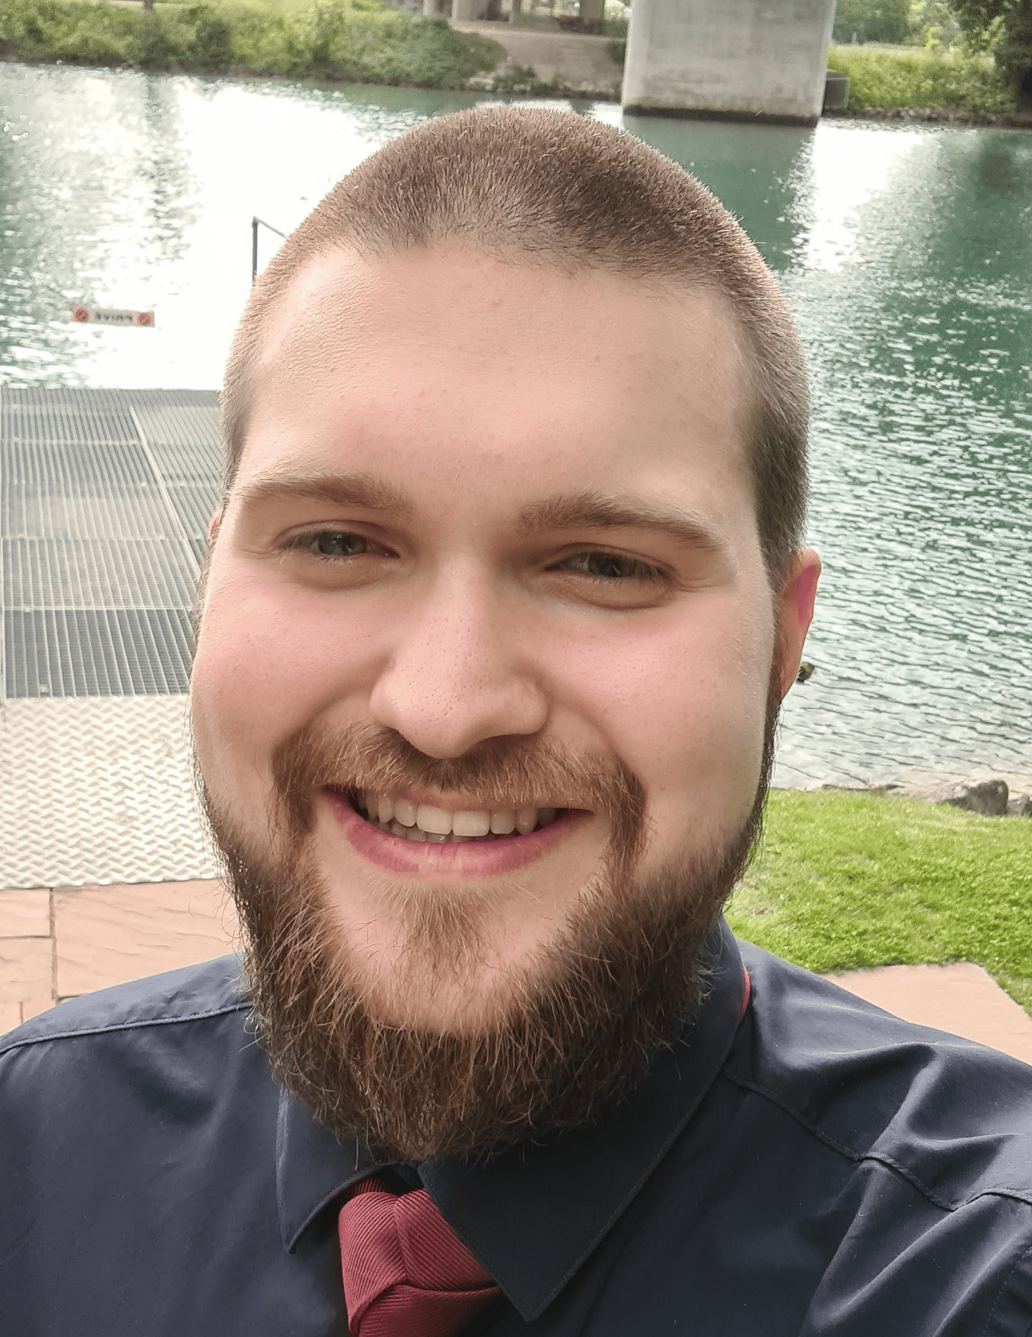




Florian Neuenschwander
University: Eastern Switzerland University of Applied Sciences
Study program: Computer Science
Year of study: 3rd Semester
City: Rapperswil, Switzerland
Motto for life: I take my time solving problems. Rushing just sounds like unnecessary effort.
Hobbies: cooking, technology, gaming, skiing
Your expectations from the summer school:
Learning about sustainability and practical eco-friendly solutions.
OST
Location where I live and work
Karlsruhe
31 August to 11 September 2026

